Slide 1

Leadership is Hard
Building a culture of safety as a business imperative

Slide 2

MindEdge Learning
Online Courses Learners Love

Slide 3
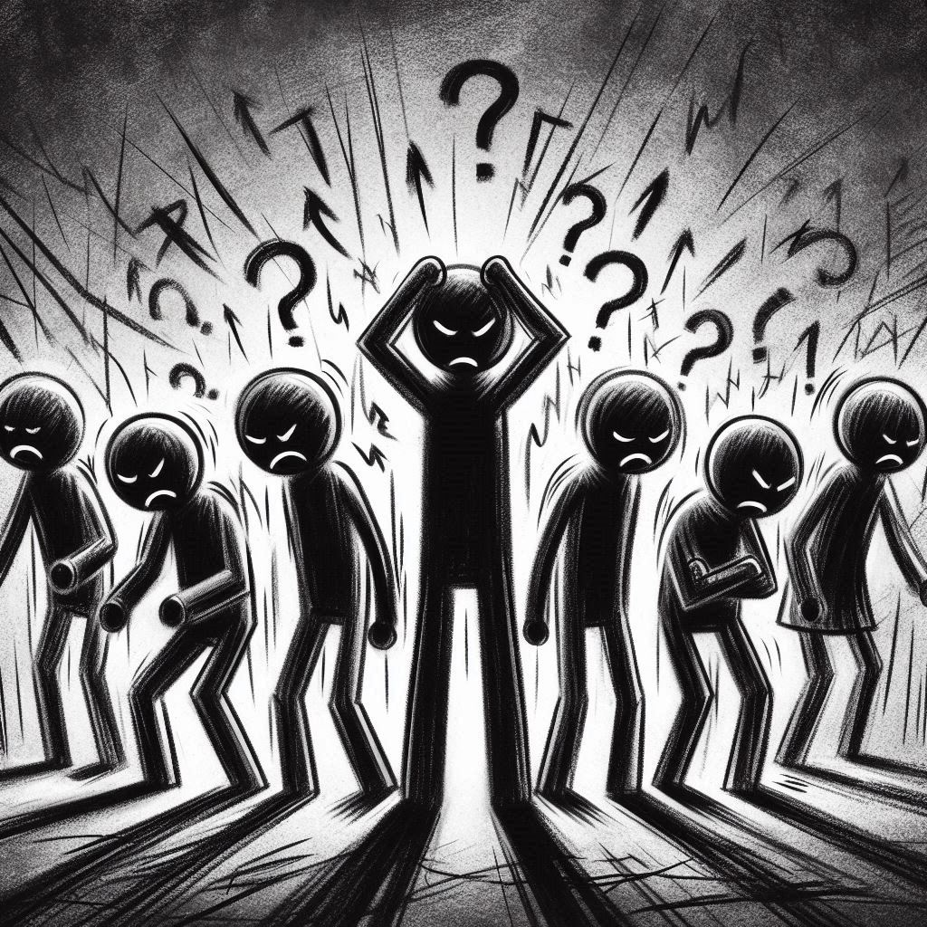
We all have stories about poor leadership

Slide 4
Recall leaders you’ve admired & happily worked for
What were their behaviours? How did you feel working for them?
What kind of worker were you, including the quality of what you produced?

Slide 5
Business imperative?

Slide 6
“When people are miserable, they disengage”
Jonathan Clark, co-author of “Leading Through”

Slide 7
“Thriving people create
thriving companies”
Jonathan Clark, co-author of “Leading Through”

Slide 8
What’s the answer?

Slide 9

It’s simple
We just need to convince your leaders to lead the “right” way!

Slide 10
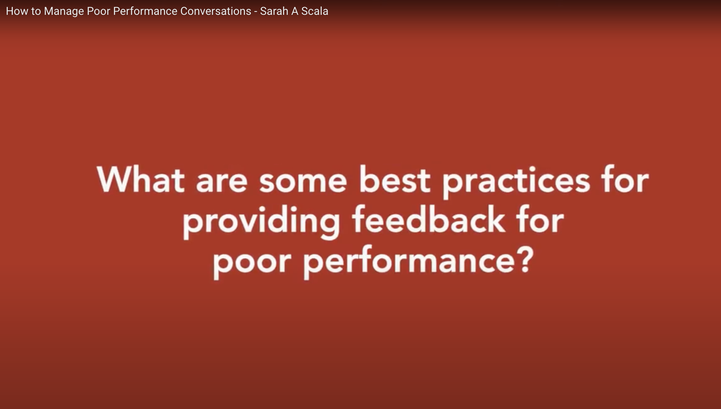

Slide 11
“You can’t change your leader”
Ken Norton - Executive Product Coach

Slide 12

Pair up: What opportunities do you have to show good leadership to those around you?

Slide 13
How?

Slide 14
Personal Reflection
Recall your own moments when you were proud of the leadership you provided (formal or informal).
What did you do? How did you behave to others? What were the results? Are you still in relationship with any of these people?

Slide 15
“There is an undeniable need for leaders to create the conditions for people to remember who they can be when free of fear, engaged and creative in work that matters to them”
Meg Wheatley, author of “Who Do We Choose to Be?”

Slide 16
How?
Make it safe

Slide 17
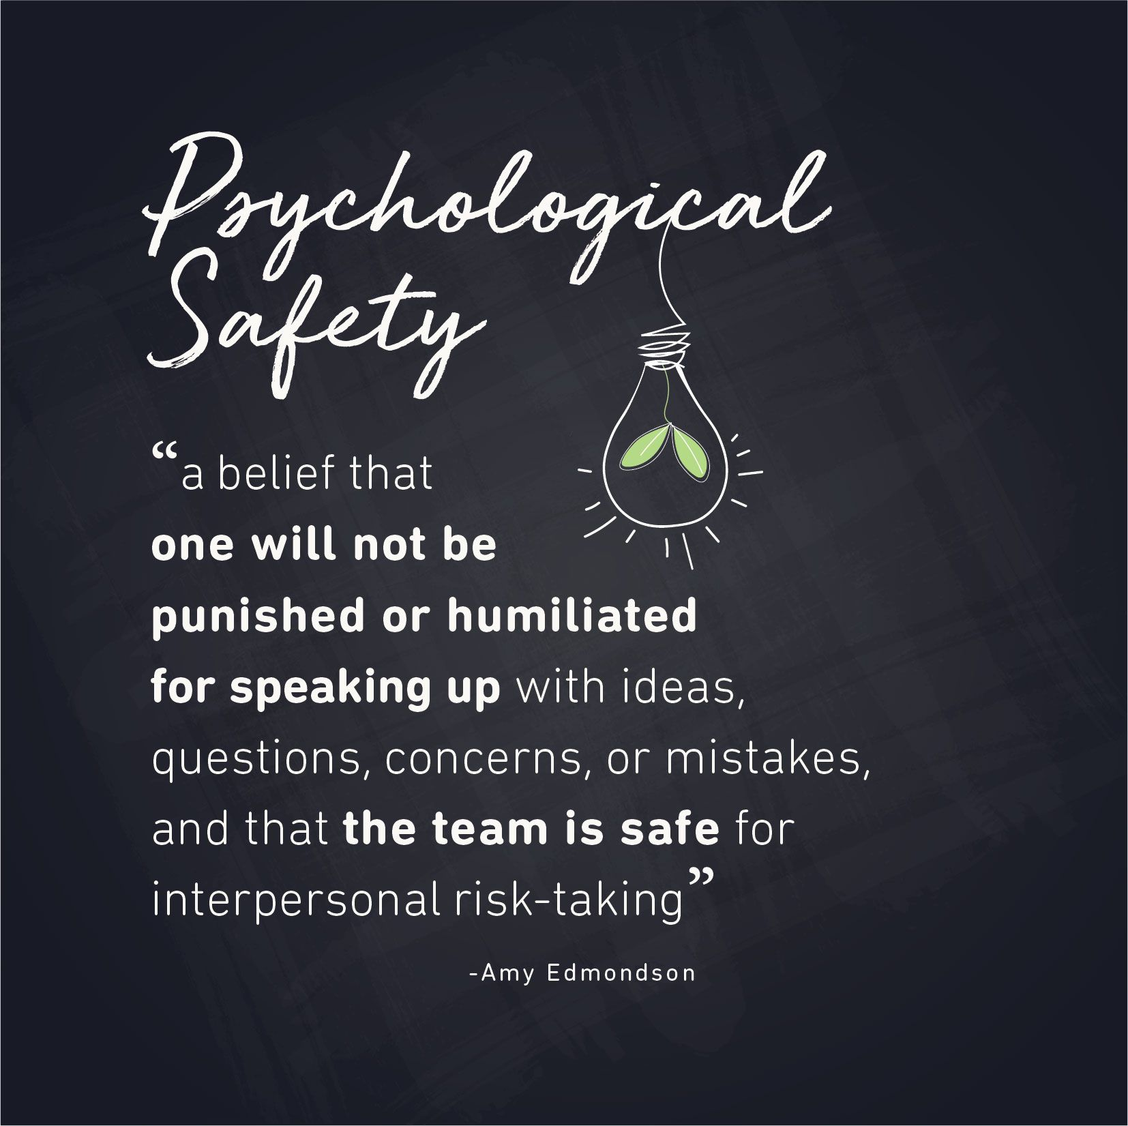

Slide 18
Collecting “Exactlys”
Do you get me?
“I know you reserve mornings for focused work, so…”
Do you care?
“It sounds like you are asking for help with…”
Do I feel heard?
“Are you suggesting we focus more on…”
“Listening [is] the first competence of leadership” - Peter Drucker

Slide 19
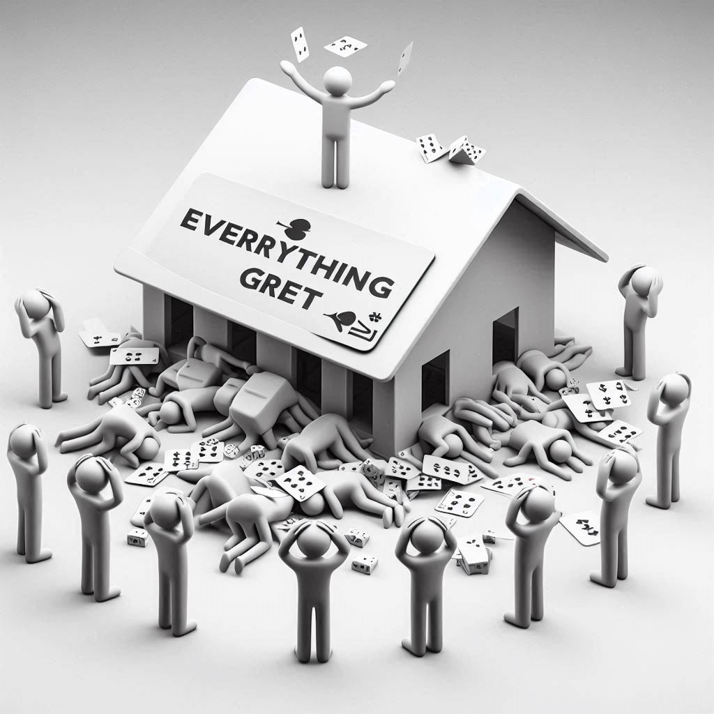
Talk about your failures openly

Slide 20
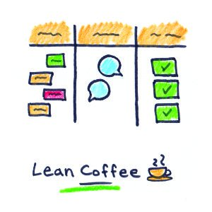
Lean Coffee
Hold an optional monthly meeting

Slide 21
How?
Make it safe
With, not to

Slide 22
“Where there is a problem, community is the answer”
Meg Wheatley

Slide 23
“Deep Democracy” (Groups of 3 or 4)
Argue the following opposing positions, in order. Each person gets a turn on #1, then reverse the order for #2:
We should collaborate more because…
We should not collaborate more because….
Then Discuss Insights

Slide 24
How?
Make it safe
With, not to
Systems Thinking

Slide 25
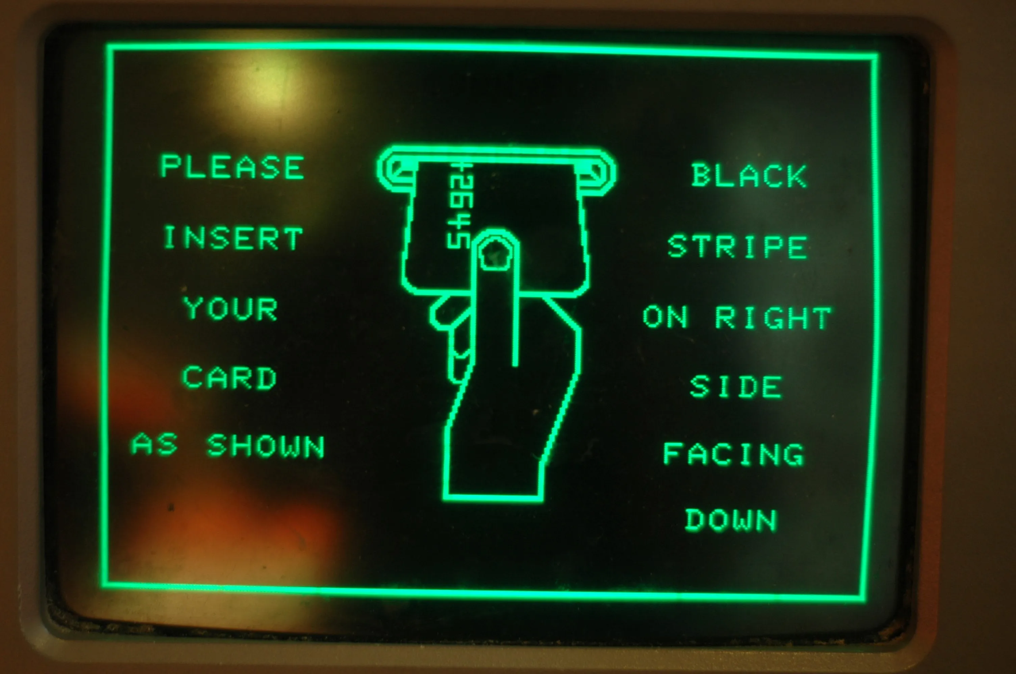

Slide 26
What systems have you observed?
Can you think of an example from your organization of a “system” that made great collaboration inevitable?

Slide 27
Last Exercise
What is one takeaway from today that you want to act on.

Slide 28
Summary & Q&A
You can’t change your leader
But you can lead from where you are
How?
Make it safe
With, not to
Systems Thinking

Slide 29
“We were together. I forget the rest.”
Meg Wheatley

